Slide 1
Computer Graphics Rendering
Lecture 15: Fast rendering pipelines (history)
Kartic Subr

Slide 2
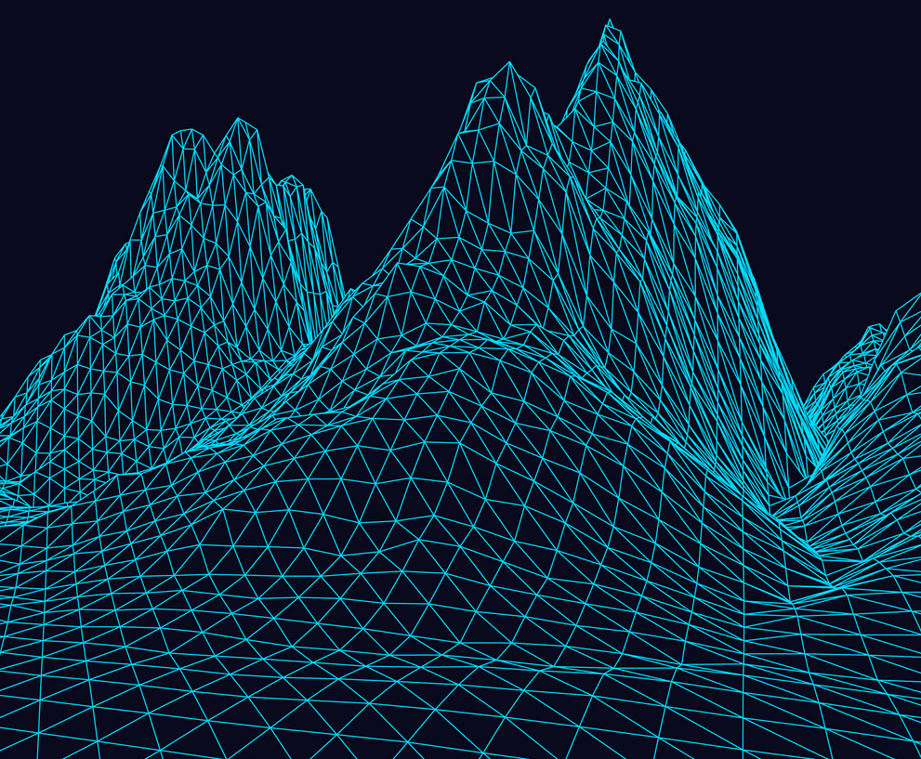
Fast rendering?

Slide 3
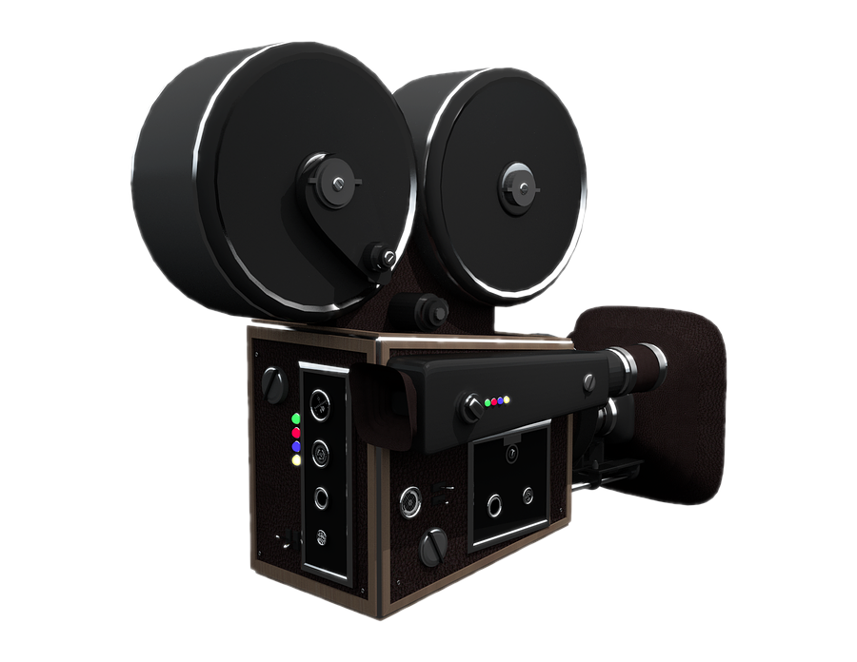
Fast rendering?

Slide 4
Fast rendering?

Slide 5
Ray tracing – slow but physically based

Slide 6
How else can we render?

Slide 7



Remember our projective transformation?
y
$$(X, Y, Z)$$
$$f$$
3D world
z=1 plane
pinhole
z
$$(−f.\frac{X}{Z},−f.\frac{Y}{Z}, −f)$$
z

Slide 8
Project each vertex (Matrix multiplication)

Slide 9
What about `in-between’ spaces?
?

Slide 10
Rasterisation

Slide 11
Considerations
Define geometry using vertices
Some geometry might not be visible
Fill space between vertices somehow
Multiple primitives might project onto the same pixel
Lighting/shading calculation
Speed, maybe use the GPU

Slide 12

… 1994
Vertex Data
Vertex Transform and Lighting
Primitive
Setup and Rasterization
Fragment Coloring and Texturing
Blending
Pixel Data
Texture Store

Slide 13
… 1992
Vertex Data
Vertex Transform and Lighting
Primitive
Setup and Rasterization
Fragment Coloring and Texturing
Blending
Pixel Data
Texture Store
Application Programming Interface (API) for
functionality that was implemented in hardware

Slide 14
… 2004
2.0
Vertex Data
Vertex Transform and Lighting
Primitive
Setup and Rasterization
Fragment Coloring and Texturing
Blending
Pixel Data
Texture Store

Slide 15
… 2010
4.1
(latest is 4.6)
Vertex Data
Vertex Shader
Primitive
Setup and Rasterization
Fragment Shader
Blending
Tessellation Control Shader
Tessellation Evaluation Shader
Geometry Shader
Pixel Data
Texture Store

Slide 16
Developing applications
Game/application main control logic
Vertex Shader
Geometry Shader
Fragment Shader

Slide 17
Real-time rendering APIs

Slide 18
The big picture
https://en.wikipedia.org/wiki/Vulkan_(API)

Slide 19
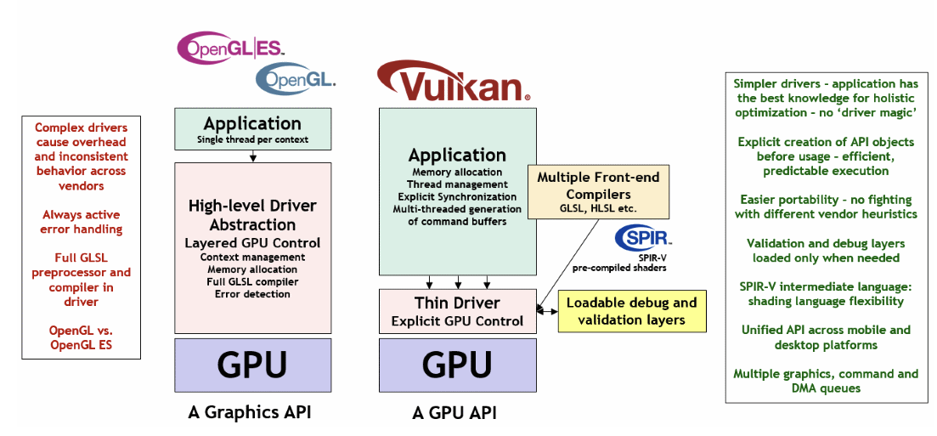
What is Vulkan
https://docs.vulkan.org/guide/latest/what_is_vulkan.html
https://docs.vulkan.org/tutorial/latest/00_Introduction.html

Slide 20
graphics pipeline
output image
(render target)

Slide 21
input
assembler
vertex
shader
hull
shader
domain
shader
geometry
shader
pixel
shader
output
merger
tessellator
rasteriser
output image
(render target)
fixed functions – change parameters
shaders – fully programmable

Slide 22
input
assembler
vertex
shader
hull
shader
tessellator
domain
shader
geometry
shader
rasteriser
pixel
shader
output
merger
0.2754 -0.5519 0.8320 0.0358 0.2428 0.7524 0.3252 0.5729
0.9154 0.3357 -0.9977 0.1759 0.9174 0.4477 0.1256 0.8853
-0.5186 0.6888 -0.0751 0.7218 0.2691 0.5301 0.4996 0.6851
0.3522 -0.3111 -0.1513 0.4735 0.7655 0.7809 0.5428 0.3092
-0.4219 0.5610 -0.0782 0.1527 0.1887 0.6633 0.4481 0.5993
0.3436 0.3507 0.5403 0.3411 0.2875 0.5849 0.6090 0.5357
0.3903 -0.9866 -0.3551 0.6074 0.0911 0.7086 0.5775 0.4054
-0.8640 0.2043 0.5695 0.1917 0.5762 0.2175 0.3645 0.9055
-0.4904 -0.2265 -0.0573 0.7384 0.6834 0.7053 0.6583 0.2633
0.2754 -0.5519 0.8320
0.9154 0.3357 -0.9977
-0.5186 0.6888 -0.0751
0.3522 -0.3111 -0.1513
-0.4219 0.5610 -0.0782
0.3436 0.3507 0.5403
0.3903 -0.9866 -0.3551
-0.8640 0.2043 0.5695
-0.4904 -0.2265 -0.0573
0.0358 0.2428
0.1759 0.9174
0.7218 0.2691
0.4735 0.7655
0.1527 0.1887
0.3411 0.2875
0.6074 0.0911
0.1917 0.5762
0.7384 0.6834
0.7524 0.3252 0.5729
0.4477 0.1256 0.8853
0.5301 0.4996 0.6851
0.7809 0.5428 0.3092
0.6633 0.4481 0.5993
0.5849 0.6090 0.5357
0.7086 0.5775 0.4054
0.2175 0.3645 0.9055
0.7053 0.6583 0.2633
0
1
2
3
4
5
6
7
8
input
assembler
position
FLOAT32
UV co-ord.
FLOAT 32
normal
FLOAT32
id
UINT16

Slide 23
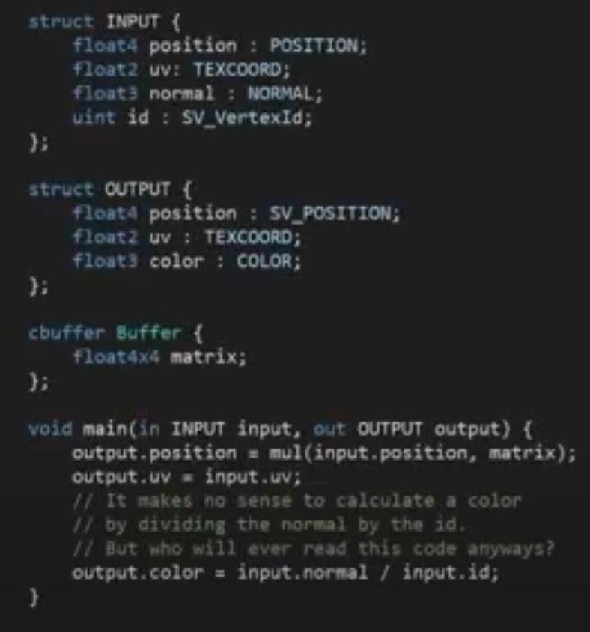
input
assembler
vertex
shader
hull
shader
tessellator
domain
shader
geometry
shader
rasteriser
pixel
shader
output
merger
Matrix
vertex attributes
transformed vertex attributes
position
0.2754 -0.5519 0.8320
position
0.2344 -0.1519 0.3320
UV co-ord.
0.0358 0.2428
vertex
shader
UV co-ord.
0.6358 0.8428
normal
0.7524 0.3252 0.5729
normal
0.1524 0.7252 0.3729
id
colour
.5 .5 .5
0

Slide 24
input
assembler
vertex
shader
hull
shader
tessellator
domain
shader
geometry
shader
rasteriser
pixel
shader
output
merger
tessellation
https://computeranimations.wordpress.com/2015/03/16/rasterization-of-parametric-curves-using-tessellation-shaders-in-glsl/

Slide 25
input
assembler
vertex
shader
hull
shader
tessellator
domain
shader
geometry
shader
rasteriser
pixel
shader
output
merger
input primitives
output primitives
geometry
shader
https://computeranimations.wordpress.com/2015/03/16/rasterization-of-parametric-curves-using-tessellation-shaders-in-glsl/

Slide 26
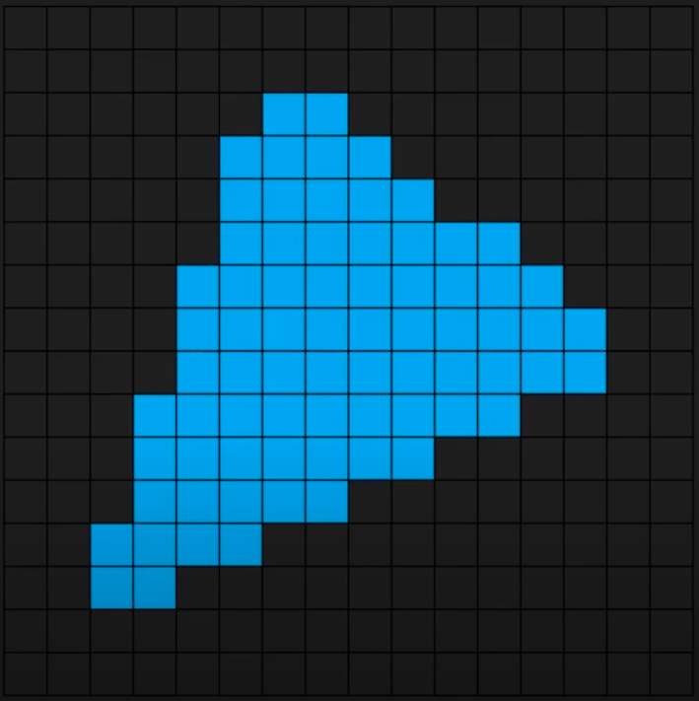
input
assembler
vertex
shader
hull
shader
tessellator
domain
shader
geometry
shader
rasteriser
pixel
shader
output
merger
rasteriser

Slide 27
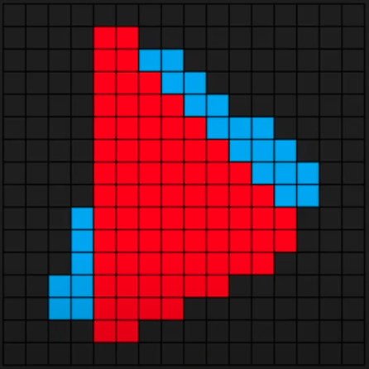
input
assembler
vertex
shader
hull
shader
tessellator
domain
shader
geometry
shader
rasteriser
pixel
shader
output
merger
rasteriser

Slide 28
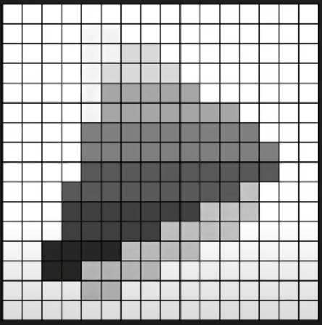
input
assembler
vertex
shader
hull
shader
tessellator
domain
shader
geometry
shader
rasteriser
pixel
shader
output
merger
rasteriser
depth map
(z-buffer)

Slide 29
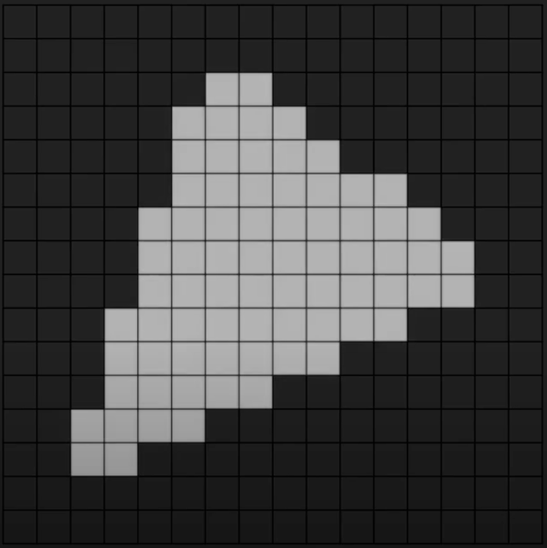
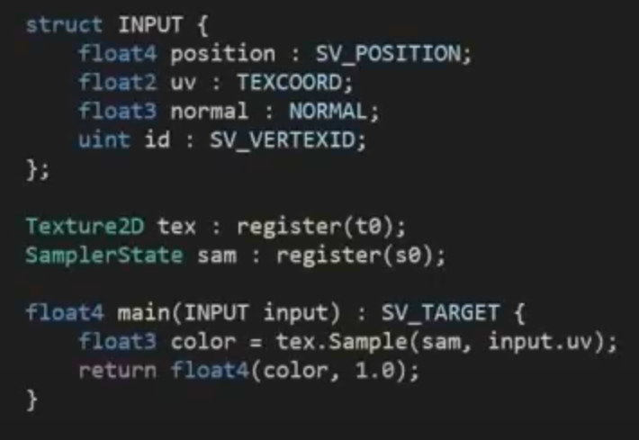
input
assembler
vertex
shader
hull
shader
tessellator
domain
shader
geometry
shader
rasteriser
pixel
shader
output
merger
Texture
Sampler
pixel
shader
colour of each pixel?

Slide 30
input
assembler
vertex
shader
hull
shader
tessellator
domain
shader
geometry
shader
rasteriser
pixel
shader
output
merger
render target
depth buffer
fragment colour
output
merger
fragment depth

Slide 31
graphics pipeline
output image
(render target)

Slide 32
Quiz – which part of the pipeline …
Define geometry using vertices
Some geometry might not be visible
Fill space between vertices somehow
Multiple primitives might project onto the same pixel
Lighting/shading calculation
Speed, maybe use the GPU

